Slide 1
Infrastructure
Notes:
Let me talk about the inference problem in some more detail.

Slide 2
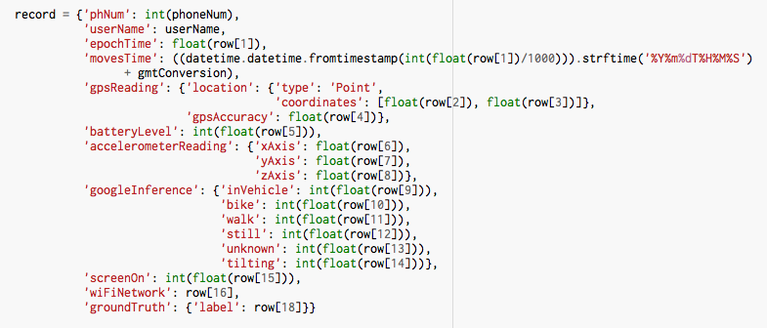
Notes:
Benefits: 1 app and more (customized) data
Issues: Battery!

Slide 3
Inference
Notes:
Let me talk about the inference problem in some more detail.

Slide 4
Location Traces
Trips
Activities
Route
Mode(s)
Purpose
Framework for inference

Slide 5
Location Traces
Trips
Activities
Route
Mode(s)
Purpose
Framework for inference

Slide 6
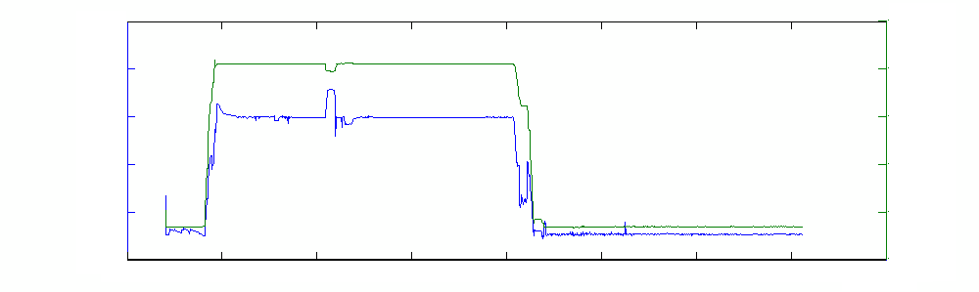
Step 1: Separating trips from activities
3-dimensional clustering, e.g. DBSCAN
Latitude
Longitude
Latitude
Longitude
Time of Day

Slide 7
Step 1: Separating trips from activities
3-dimensional clustering, e.g. DBSCAN
Metric | Observations | Accuracy
Time (hours) | 2213 | 97%
Distance (miles) | 4774 | 81%
Activities (number) | 842 | 92%
Trips (number) | 592 | 82%

Slide 8
Step 2: Identifying change points for a trip
Rule-based classification
BART
Bike
Downtown Berkeley BART
Hartford
and 19th St.

Slide 9
Step 2: Identifying change points for a trip
Rule-based classification
BART
Bike
Downtown Berkeley BART
Hartford
and 19th St.
Trip 1
West Oakland BART
Trip 2

Slide 10
Step 2: Identifying change points for a trip
Rule-based classification
BART
Downtown Berkeley BART
West Oakland BART

Slide 11
Step 2: Identifying change points for a trip
Rule-based classification
BART
Downtown Berkeley BART
West Oakland BART
Step 2A: Label GPS points as walk points or non-walk points, where a walk point is defined as a point at which the speed is less than 5 mph and acceleration is less than 1620 mph². Points where GPS accuracy is unacceptably low are skipped over.

Slide 12
Step 2: Identifying change points for a trip
Rule-based classification
BART
Bike
West Oakland BART
Hartford
and 19th St.
Step 2A: Label GPS points as walk points or non-walk points, where a walk point is defined as a point at which the speed is less than 5 mph and acceleration is less than 1620 mph². Points where GPS accuracy is unacceptably low are skipped over.

Slide 13
Step 2: Identifying change points for a trip
Rule-based classification
BART
Bike
West Oakland BART
Hartford
and 19th St.
Step 2A: Label GPS points as walk points or non-walk points, where a walk point is defined as a point at which the speed is less than 5 mph and acceleration is less than 1620 mph². Points where GPS accuracy is unacceptably low are skipped over.

Slide 14
Step 2: Identifying change points for a trip
Rule-based classification
BART
Bike
West Oakland BART
Hartford
and 19th St.
Non-walk
Step 2B: Identify walk and non-walk segments as consecutive walk or non-walk points that exceed 90 seconds in duration.

Slide 15
Step 2: Identifying change points for a trip
Rule-based classification
BART
Bike
West Oakland BART
Hartford
and 19th St.
Non-walk
Walk
Step 2B: Identify walk and non-walk segments as consecutive walk or non-walk points that exceed 90 seconds in duration.

Slide 16
Step 2: Identifying change points for a trip
Rule-based classification
BART
Bike
West Oakland BART
Hartford
and 19th St.
Non-walk
Walk
Non-walk
Step 2B: Identify walk and non-walk segments as consecutive walk or non-walk points that exceed 90 seconds in duration.

Slide 17
Step 2: Identifying change points for a trip
Rule-based classification
BART
Bike
West Oakland BART
Hartford
and 19th St.
Non-walk
Walk
Non-walk
Non-walk
Step 2B: Identify walk and non-walk segments as consecutive walk or non-walk points that exceed 90 seconds in duration.

Slide 18
Step 2: Identifying change points for a trip
Rule-based classification
BART
Bike
West Oakland BART
Hartford
and 19th St.
Non-walk
Walk
Non-walk
Non-walk
Step 2C: Merge unidentified segments with identified backward segment.

Slide 19
Step 2: Identifying change points for a trip
Rule-based classification
BART
Bike
West Oakland BART
Hartford
and 19th St.
Non-walk
Walk
Non-walk
Step 2C: Merge unidentified segments with identified backward segment.

Slide 20
Step 2: Identifying change points for a trip
Rule-based classification
BART
Bike
West Oakland BART
Hartford
and 19th St.
Non-walk
Walk
Non-walk
What if there are no identified backward segments?

Slide 21
Step 2: Identifying change points for a trip
Rule-based classification
BART
Bike
West Oakland BART
Hartford
and 19th St.
Non-walk
Walk
Non-walk
What if there are no identified backward segments?

Slide 22
Step 2: Identifying change points for a trip
Rule-based classification
BART
Bike
West Oakland BART
Hartford
and 19th St.
Non-walk
Walk
Non-walk
What if there are no identified backward segments?
Step 2D: Merge consecutive unidentified segments into a single segment. If average speed over the segment is less than 5.6 m/s, classify it as a walk segment. If not, classify it as a non-walk segment.

Slide 23
Step 2: Identifying change points for a trip
Rule-based classification
BART
Bike
West Oakland BART
Hartford
and 19th St.
Walk
Non-walk
Walk
Non-walk
What if there are no identified backward segments?
Step 2D: Merge consecutive unidentified segments into a single segment. If average speed over the segment is less than 5.6 m/s, classify it as a walk segment. If not, classify it as a non-walk segment.

Slide 24
Step 2: Identifying change points for a trip
Rule-based classification
BART
Bike
West Oakland BART
Hartford
and 19th St.
Walk
Non-walk
Walk
Non-walk
What if there are no identified backward segments?
Step 2D: Merge consecutive unidentified segments into a single segment. If average speed over the segment is less than 5.6 m/s, classify it as a walk segment. If not, classify it as a non-walk segment.
Step 2E: Finally, if the segment duration is less than 90 seconds, merge it with the nearest forward segment.

Slide 25
Step 2: Identifying change points for a trip
Rule-based classification
BART
Bike
West Oakland BART
Hartford
and 19th St.
Non-walk
Walk
Non-walk
What if there are no identified backward segments?
Step 2D: Merge consecutive unidentified segments into a single segment. If average speed over the segment is less than 5.6 m/s, classify it as a walk segment. If not, classify it as a non-walk segment.
Step 2E: Finally, if the segment duration is less than 90 seconds, merge it with the nearest forward segment.

Slide 26
Step 3: Identifying travel mode for trip segments
Supervised classification
Feature Set
Distance
Speed profiles
Acceleration profiles
Heading change
Classifier
Decision Tree
Logistic Regression
Support Vector Machines
Neural Networks
Travel Mode
Walk
Bike
Transit
Car

Slide 27
Step 3: Identifying travel mode for trip segments
Supervised classification
Feature Set
Distance
Speed profiles
Acceleration profiles
Heading change
Classifier
Decision Tree
Logistic Regression
Support Vector Machines
Neural Networks
Travel Mode
Walk
Bike
Transit
Car
Features from 632 segments (52% walk, 20% bike, 10% car and 18% transit) were used to construct a decision tree, which correctly predicted travel mode for 66% of the 70 segments in the hold out sample

